Slide 1
Deploying Solution Apps on Reflex
Module 5

Slide 2
Agenda
Dockerize application for Reflex deployment
Templatizing for Kubernetes
Automate through Reflex Provisioner (Ansible)

Slide 3
What are Containers
Linux containers use cgroups and namespaces to isolate self contained environment with isolated CPU, memory, block I/O and network resources that share the kernel of host OS.
Container consists of:
Runtime environment
Application
App dependencies
Libraries and other binaries
Configuration files
Notes:
What are containers?
Container are based on LXC (Linux Containers) technology which use linux cgroups and namespaces to isolate self contained execution environments—with their own, isolated CPU, memory, block I/O, and network resources—that share the kernel of the host operating system.
Linux cgroups - govern the isolation and usage of system resources, such as CPU and memory, for a group of processes. namespaces deal with resource isolation for a single process
Docker is a Linux utility that can efficiently create, ship, and run containers.
Put simply, a container consists of an entire runtime environment: an application, plus all its dependencies, libraries and other binaries, and configuration files needed to run it, bundled into one package. By containerizing the application platform and its dependencies, differences in OS distributions and underlying infrastructure are abstracted away.

Slide 4
What is Docker
Docker is a Linux Utility for development, shipment and deployment.

Slide 5

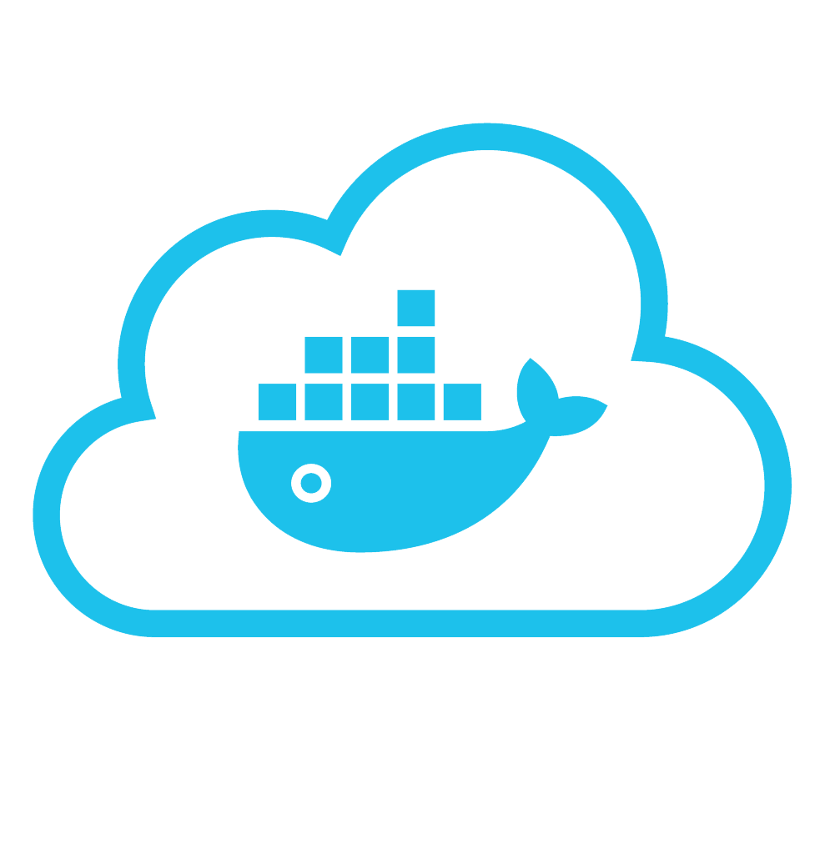



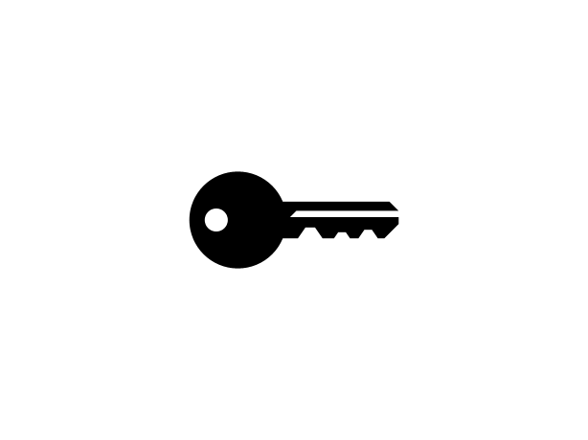

Put it all together: Build, Ship, Run Workflow
Developers
IT Operations
BUILD
Development Environments
SHIP
Create & Store Images
RUN
Deploy, Manage, Scale
Notes:
Local development environments
Self service app images
Build, Test, Deploy applications
Define app behavior and infra needs
Registry services for image storage, management and distribution
IT Ops maintains library of secure base content
Manage role based access to repos/images
Management consoles
Provision, manage infrastructure resources
Monitor, manage, scale infrastructure and applications

Slide 6
Build, Ship and Run
Build
docker build -t nginx:1.12.2-1 .
Ship
docker tag nginx:1.12.2-1 <docker-registry>:<port>/nginx:1.12.2-1
docker push <docker-registry>:<port>/nginx:1.12.2-1
Run
docker run --name nginx-test -d -p 8000:80 <docker-registry>:<port>/nginx:1.12.2-1

Slide 7
Some Docker Vocabulary
Docker Client
Docker Server
Docker images
Docker container
Docker Hub/Registry
Dockerfile
Notes:
Let’s take a look at what build, ship run means in a little more detail, but before that we need to level set some Docker vocabulary and commands:
Image
The static component that represents a on-running applicatoin
Containers are derived from images
images contain EVERYTHING an application needs to run
Should always be built via a Dockerfile (which we’ll talk about in a bit_
Container
The standard unit in which the application service resides
Package app and dependencies together
Isolated from other containers
One container per app / service
Docker Engine
The program that creates, ships and runs containers
Deployable on any physical or vm host locally, in datacenters or cloud
Communicates with Docker Hub
Registry
The service that store, distributes and manages container images
Receives commands from Docker Client via Engine
Access control with public, private repos

Slide 8
Basic Docker Commands
docker images
docker build
docker pull
docker run
docker ps
docker inspect
docker info
docker stop
docker rmi
docker rm
docker kill

Slide 9
# Pull base image.
FROM centos:centos7
# Labels for maintaining image metadata
LABEL Component="nginx" Version="1.12.2-1" maintainer="NGINX Docker Maintainers <docker-maint@nginx.com>"
ENV nginxversion="1.12.2-1" os="centos" osversion="7" elversion="7_4"
# Install nginx
RUN yum install -y wget openssl sed net-tools && yum -y autoremove && yum clean all &&\
wget http://nginx.org/packages/$os/$osversion/x86_64/RPMS/nginx-$nginxversion.el$elversion.ngx.x86_64.rpm &&\
rpm -iv nginx-$nginxversion.el$elversion.ngx.x86_64.rpm
# Add default config file
COPY conf/nginx.conf /etc/nginx/nginx.conf
ADD html/ /usr/share/nginx/html/
# Define mountable directories.
VOLUME ["/usr/share/nginx/html/"]
# Define working directory.
WORKDIR /etc/nginx
# Define default command.
CMD ["nginx"]
# Expose ports.
EXPOSE 80
Sample Dockerfile

Slide 10
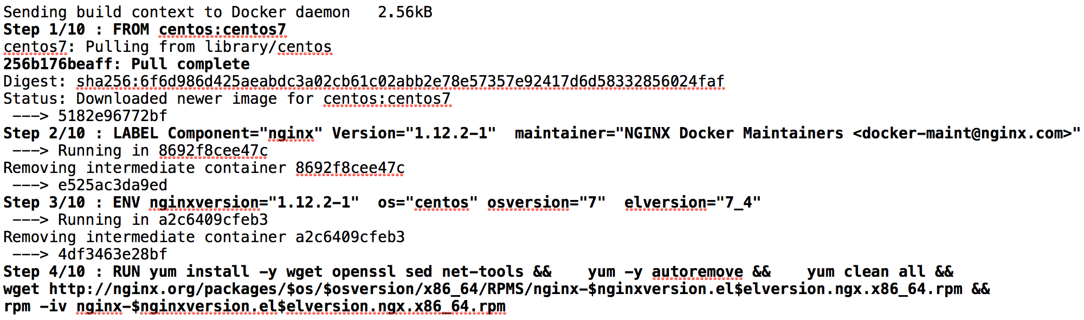
Build
Docker build –t nginx:1.12.2-1 .

Slide 11
Docker Images
…
Install Requirements
Copy Requirements
Upgrade Pip
Install Python and Pip
Alpine Linux
Kernel
Notes:
How container works?
Fundamentally, both Docker and LXC containers are user-space lightweight virtualization mechanisms that implement cgroups and namespaces to manage resource isolation.
- Docker is all about layers. Knowledge how they work is essential.
* Each command in Dockerfile creates so-called layer
* Layers are cached and reused
* Invalidating cache of a single layer invalidates all subsequent layers
* Invalidation occurs after command change, if copied files are different, or build variable is other than previously
* Layers are immutable, so if we add a file in one layer, and remove it in the next one, image STILL contains that file (it's just not available in the container)!

Slide 12
Docker File System
Logical file system by grouping different file system primitives into branches (directories, file systems, subvolumes, snapshots)
Each branch represents a layer in a Docker image
Allows images to be constructed / deconstructed as needed vs. a huge monolithic image (ala traditional virtual machines)
When a container is started a writeable layer is added to the “top” of the file system

Slide 13
Docker Guidelines
Docker
Docker containers are intended to run only one single process with PID 1 to ensure graceful shutdown of this process on docker stop.
Avoid storing application data or logs in your container.
External mounted volumes for data.
Processes in docker containers must not run with root user.
Notes:
Docker containers are intended to run only one single process with PID 1 to ensure graceful shutdown of this process on docker stop.
Docker containers are immutable – The OS, library versions, configurations, folders, and application are all wrapped inside the container.
Avoid storing application data or logs in your container. This increases the size of your container and is less efficient from an I/O perspective.Instead, store data using external mounted volumes.
When possible, design your application with the ability to scale.
Processes in docker containers must not run with root user.
Docker container build environment must be in github.
Docker container updates must happen through pull request.
Docker containers must build through jenkins and jenkinsfile must be committed with source code in github.
Devops must be involved in docker images pull request review.

Slide 14
Dockerfile Guidelines
Use proper base image
Unnecessary files should be cleaned up
Merge multiple RUN command into one
Write .dockerignore
Set WORKDIR and CMD
Prefer COPY over ADD.
Least frequent changes at the top of our Dockerfile to leverage caching.
Specify default environment variables, ports and volumes.
Add metadata to image using LABEL.
Proper tagging for images.
Notes:
Use proper base image which already contains the required package example JDK should be part of the base image if required for containerizing an app.
Unnecessary files should be cleaned up to control docker image size like Package manager caches, packages needed for build-time only, default packages not required etc.
Merge multiple RUN command into one but merge commands with similar probability of changing.
Write .dockerignore - Important to avoid all files as part of the context preparation.
Set WORKDIR and CMD, WORKDIR command changes default directory, where we run our RUN / CMD / ENTRYPOINT commands.
Prefer COPY over ADD.
We should put least frequent changes at the top of our Dockerfile to leverage caching.
Specify default environment variables, ports and volumes.
Add metadata to image using LABEL.

Slide 15
Application Challenges
Multi-machine
Service Discovery and naming
Scaling
Fault Tolerance and recovery
High Availability
Deployment lifecycle
Load balancing
Etc.
Container Orchestrator tackles these well. This is where Kubernetes comes in.

Slide 16
Kubernetes
Developed at google; used 10+ years.
Kubernetes is a Container Orchestrator or Cluster Manager.
Places container on nodes
Recovers automatically from failures
Basic monitoring, logging and health checking
Enables containers to find each other

Slide 17
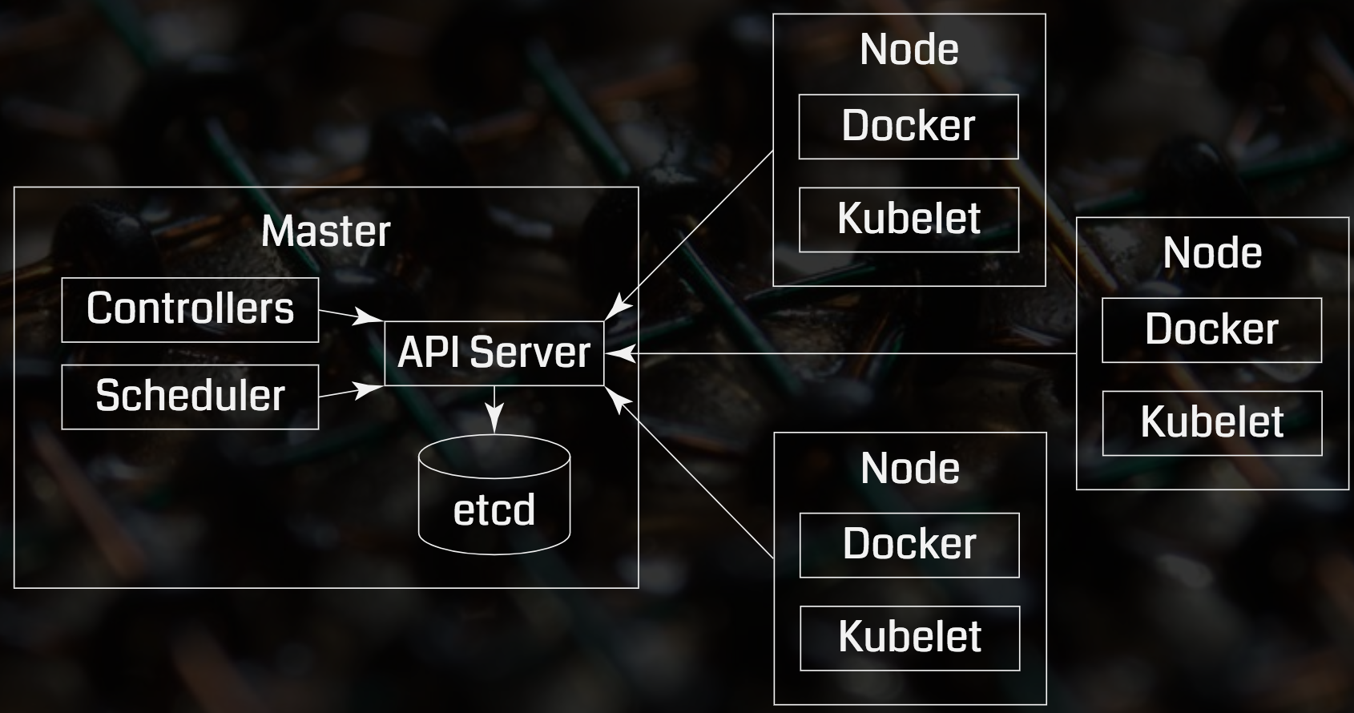
Core Concepts: Cluster

Slide 18
Kubernetes Resources
There are many but we will focus on below 3 of them.
ConfigMaps
Deployments
Services
To port the application to Kubernetes; we need to create K8s spec files for these resources.

Slide 19
ConfigMaps
ConfigMaps is used to bind the following to your containers and system components at runtime:
Configuration files
Port numbers
Other configuration artifacts
Separates configurations from containers which helps with:
Workload Portability
Ease of change or manage configurations
Prevents hardcoding configurations

Slide 20
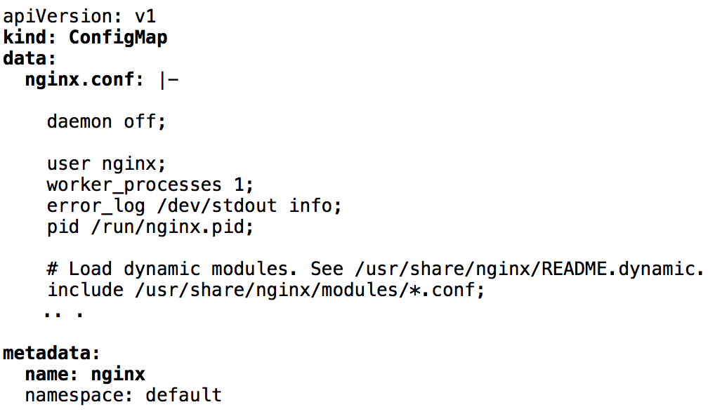
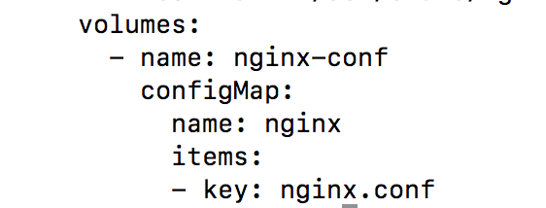
Sample Use Case | Configmaps spec snippet (nginx-cfg.yml)
nginx-dep.yml
Metadata is used for filter resources

Slide 21
Deployments Resource
Is used to describe and ensure a desired state of your application.
Can control or change the actual state to desired at a controlled rate.
kubectl create –f nginx-dep.yml
kubectl get deployments
kubectl describe deployments

Slide 22
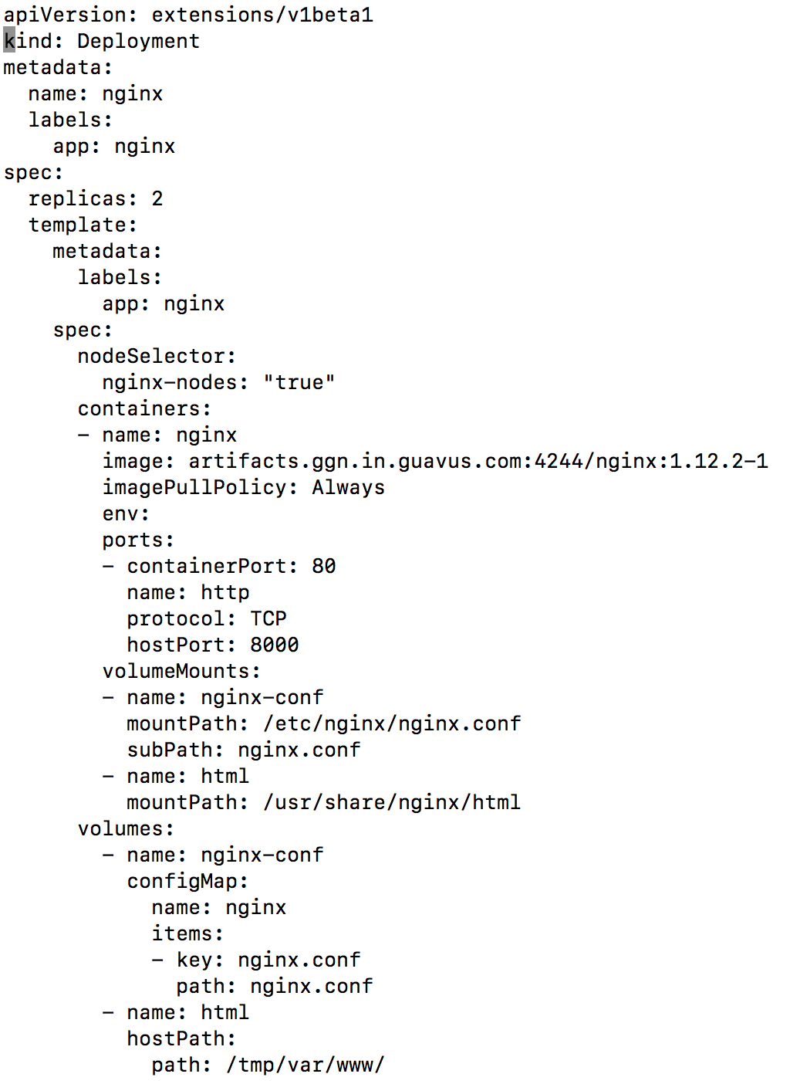
Deployment Spec
Kind of Resource
Name of Deployment Resource
Used for filtering
Running 2 containers in this deployment
Used to control the nodes on which the container should be launched
Referring to configmap

Slide 23
Services Resource
an abstraction which defines a logical set of Pods and a policy by which to access them - sometimes called a micro-service.

Slide 24
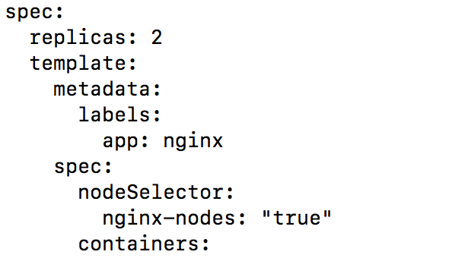
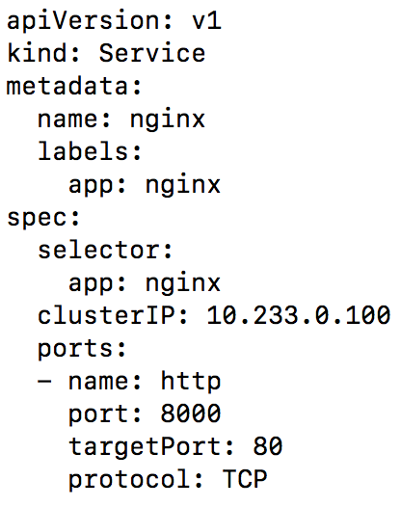
Services Spec
Referenced in Deployment spec
Service resource metadata
Assign fixed IP to Service resource (Optional)

Slide 25
Common Kubernetes commands
Kubectl create –f nginx-svc.yml
Kubectl get cm
Kubectl get deploy
Kubectl get svc
Kubectl get pods
Kubectl log <pod-name>
Kubectl describe
Kubectl delete

Slide 26
Kubernetes Template Guidelines
Must contain liveness probes.
Pod logs must be pushed to centralized logging cluster (fluentd)
Deployment node selection using ansible hosts groups.
Pods metadata (name and labels) must be defined.
Communication between pods must be through service resource.
Pods data and log files must be mounted externally
Secrets must be used to store sensitive data.
Configmaps must be used to store non-sensitive configuration files.
Notes:
Kubernetes deployment must contain liveness probes.
Kubernetes application pod logs must be pushed to centralized logging cluster (fluentd sidecar)
Kubernetes deployment nodes must be selected (labels) using ansible hosts groups.
Kubernetes pods metadata (name and labels) must be defined.
Kubernetes communication between different pods must be configured through service resource.
Kubernetes pods data and log files must be mounted outside (on PeristentVolumes or host machine)
Kubernetes secrets must be used to store sensitive data.
Kubernetes config maps must be used to store non-sensitive configuration files.
Devops must be involved in kubernetes templates pull request review.

Slide 27
Automate Deployment

Slide 28
Ansible Playbook/Role
In this section, we will learn how to create ansible playbook to deploy and undeploy your applications(nginx app, in this example) in Reflex cluster.
We will achieve that by writing an ansible playbook/role for each.
We use a role as a best practice for reusability and to avoid complex playbooks.

Slide 29
Common Steps to deploy/undeploy applications on Reflex
Create application directory under /etc/reflex-provisioner/playbooks for the app.
For example: /etc/reflex_provisioner/playbooks/nginx
Create the playbook for deploy and undeploy.
playbooks/nginx/deploy-nginx.yml
playbooks/nginx/undeploy-nginx.yml
Create a deploy role and an undeploy role under app directory.
roles/nginx/deploy
roles/nginx/undeploy
Test the playbook.

Slide 30
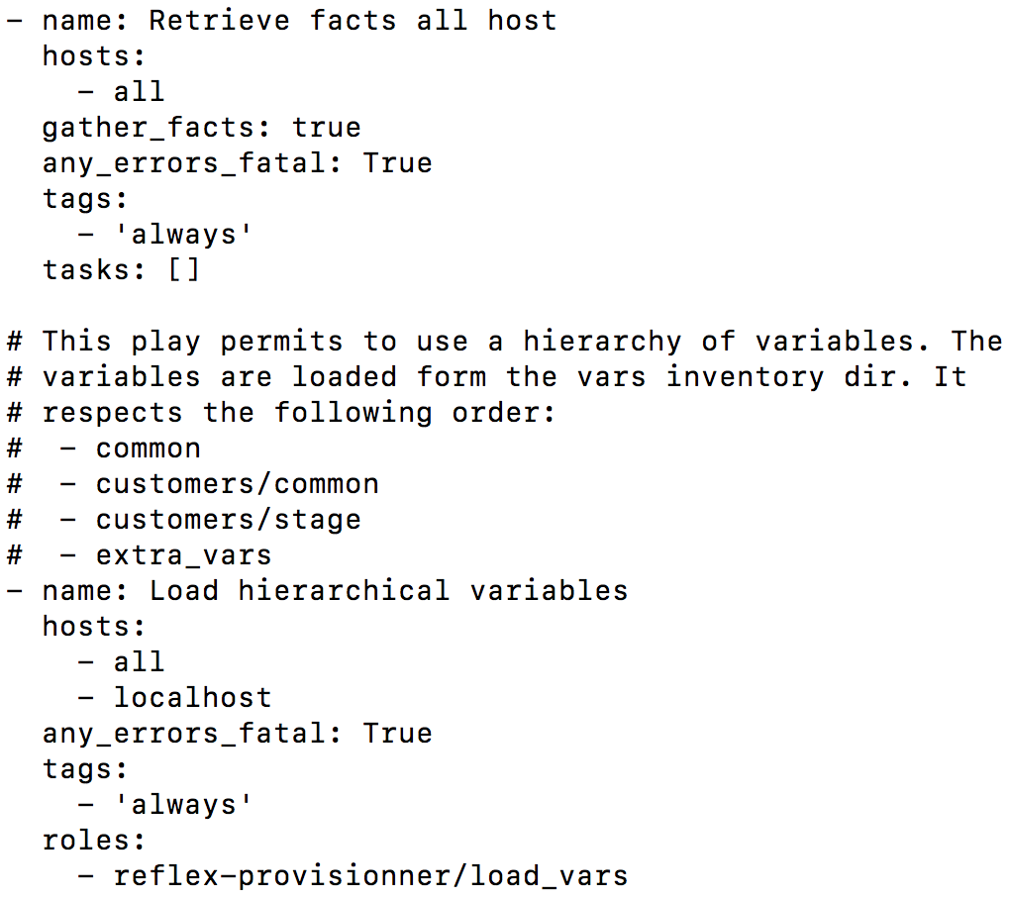
2. Playbook to Deploy the Application(deploy-nginx.yml)
Common plays used in all Reflex playbooks
Play to Retrieve the facts of all the hosts
Play to load variables from vars inventory dir

Slide 31
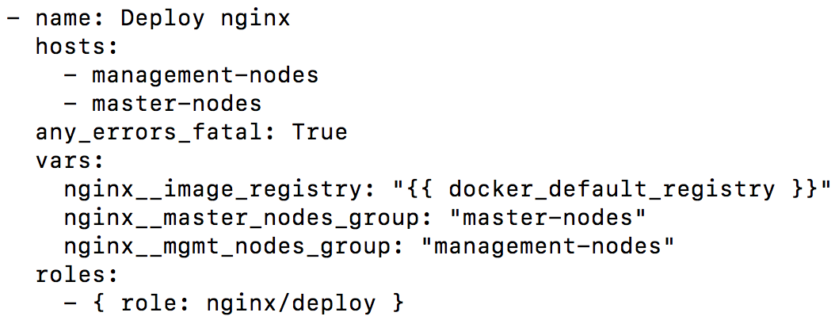
2. Playbook to Deploy the Application(deploy-nginx.yml) (continues)
Play to deploy nginx App.
Hosts to deploy the application, can be controlled in the role.
Set of variables to be used in the role playbooks
Is a reflex platform variable being used
Refers to Deploy role that performs the deployment

Slide 32
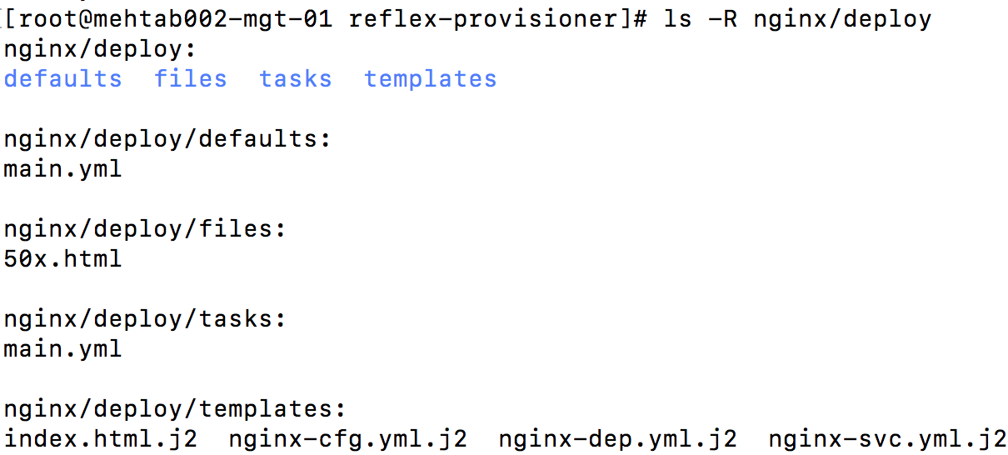
3. Writing the Role (1)
Directory for deploy role
Define application specific variables
Files/Configuration files without variables
Contains plays to perform setup
Contains files/configuration files with variables

Slide 33
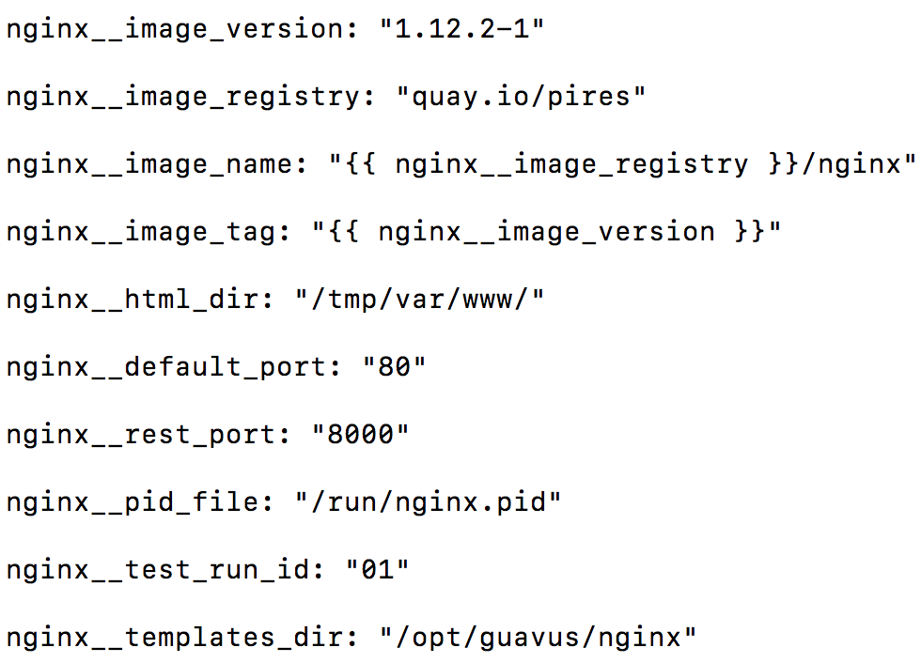
3. Writing the Role (2)
deploy/defaults/main.yml

Slide 34
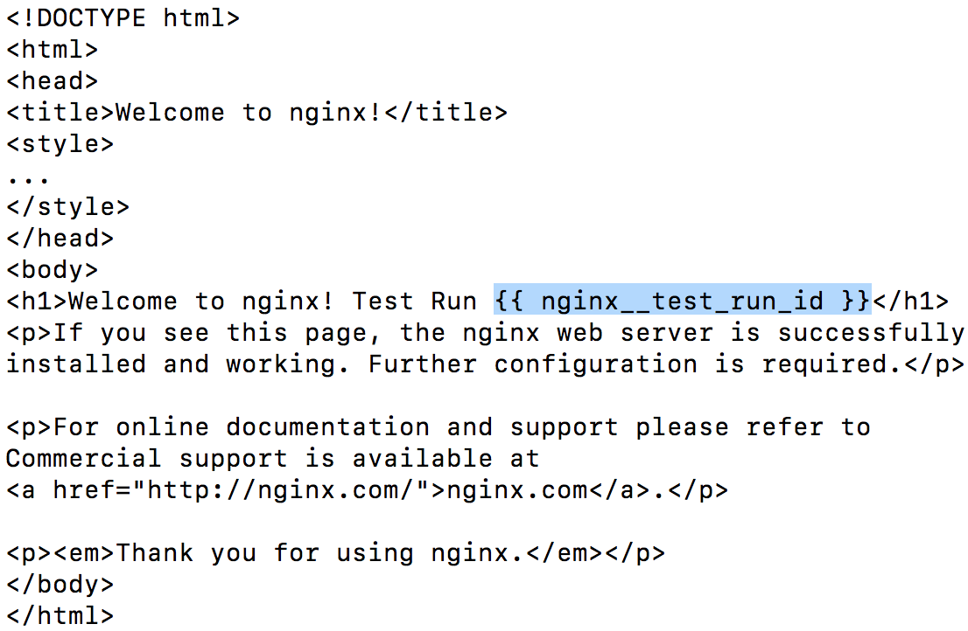
3. Writing the Role (3)
deploy/templates/index.html.j2
Resolve at runtime

Slide 35
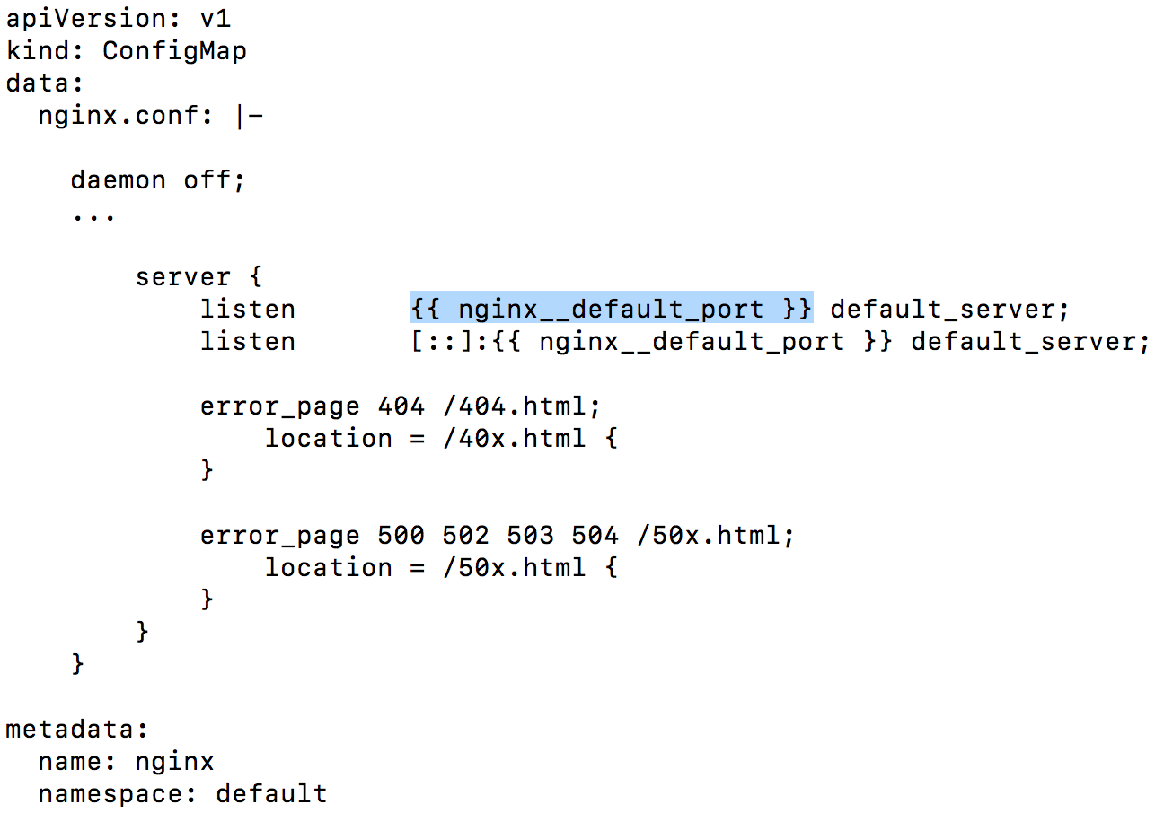
3. Writing the Role (4)
deploy/templates/nginx-cfg.yml.j2
Resolve at runtime

Slide 36
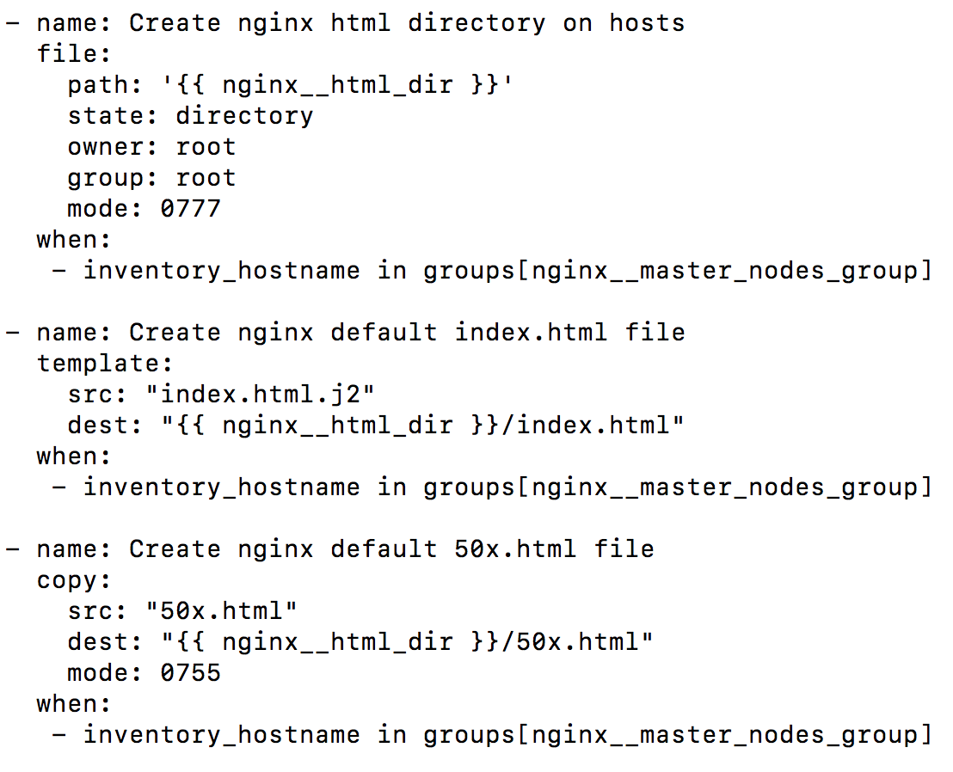
3. Writing the Role (5)
deploy/tasks/main.yml

Slide 37
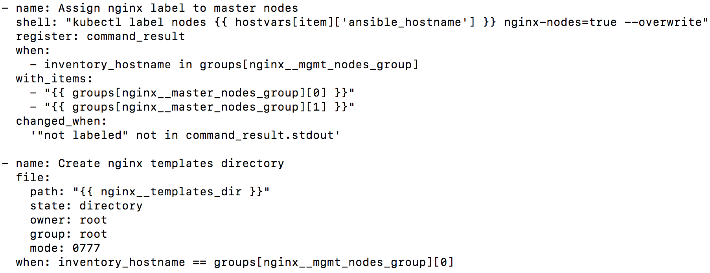
3. Writing the Role (6)
deploy/tasks/main.yml
Resolve default ansible fact
Ansible looping construct
To control the remote host where config needs to be applied

Slide 38
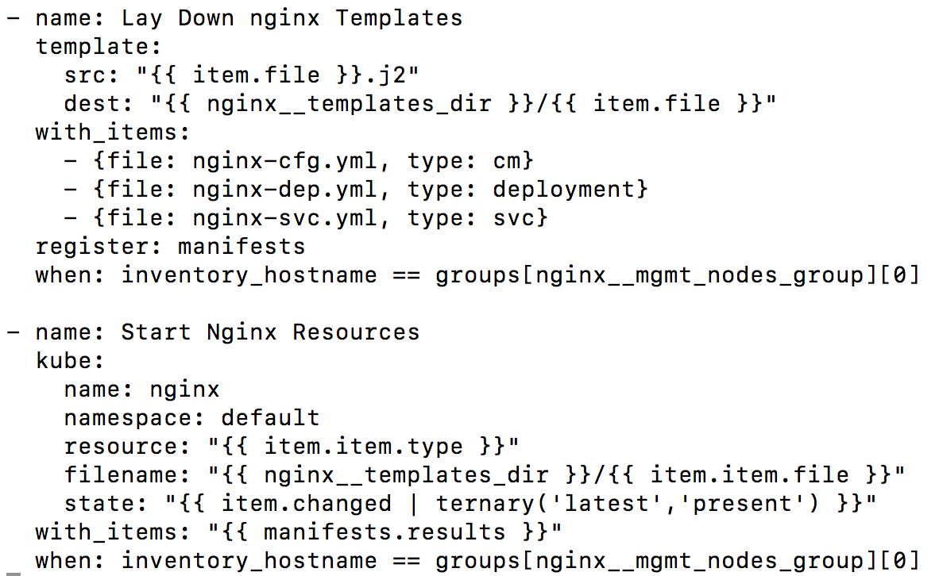
3. Writing the Role (7)
deploy/tasks/main.yml

Slide 39
Undeploy Role
Perform the similar steps for undeploy playbook/role

Slide 40
4. Test the Playbook
Deploy
ansible-playbook -i inventory/generated/<env-type>/<inventory-name>/hosts playbooks/nginx/deploy-nginx.yml --user root --ask-pass
Undeploy
ansible-playbook -i inventory/generated/<env-type>/<inventory-name>/hosts playbooks/nginx/undeploy-nginx.yml --user root --ask-pass

Slide 41
Ansible Provisioner Guidelines
Ansible code deployment as well as undeployment must be written.
Ansible code must be idempotent.
Ansible for a module deployment must have a installation flag (true/false).
Ansible module code must be reusable and not completely dependent on base platform.
Ansible module code external variables must be created in playbook and referred in role.
Notes:
Ansible provisioner must be written in the beginning with module deployment.
Ansible code for deployment and undeployment must be written.
Ansible Code must be idempotent.
Ansible code for a module must be written based split provisioner appraoch.
Ansible for a module deployment must have a installation flag (true/false).
Ansible module code must be reusable and not completely dependent on base platform.
Ansible module code external variables must be created in playbook and referred in role.
Ansible code must be in github.
Ansible code must be merged through pull requst.
Ansible code Review comments must be added in pull request.
DevOps must also be added in Ansible code pull request.

Slide 42
Provisioning ElasticSearch Subsystem

Slide 43
ES SubSystem Cluster
Cluster Node Types:
Master
Controls the cluster
Coordinator
Requests may involve data held on multiple nodes.
It executes such requests as scatter and gather phases.
Ingest
Holds data and perform data related ops such as CRUD, search and aggregations.
Data
Apply an ingest pipeline to a document in order to transform and enrich the doc before indexing.
With heavy ingest load, it makes sense to use dedicated ingest nodes.

Slide 44
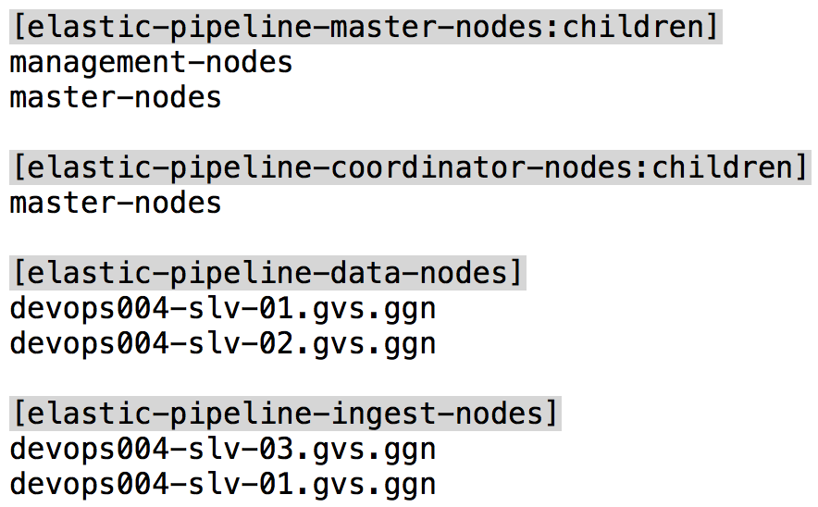
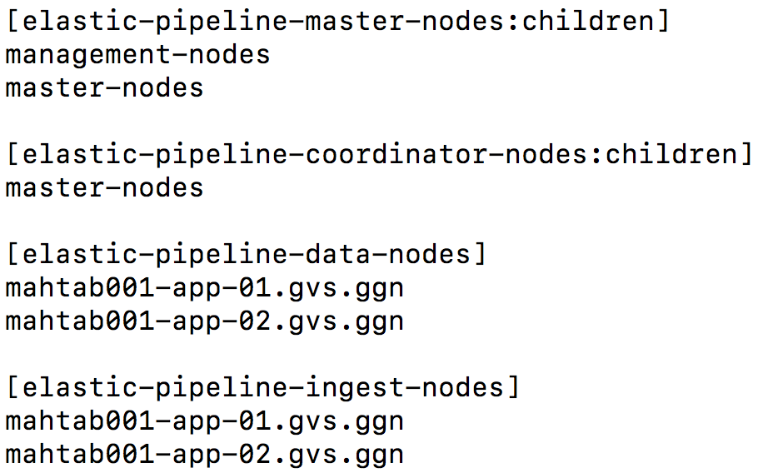
ES Node Types in Ansible Inventory
Run ES on dedicated (App) nodes in case of heavy data load.

Slide 45
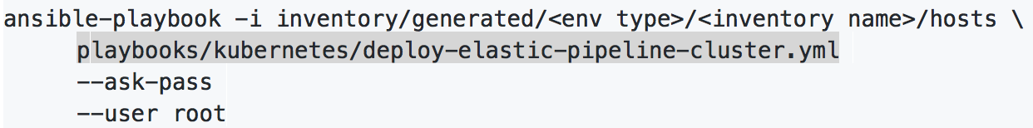
ElasticSearch Ansible Playbook
./scripts/generate_inventory/cli.py refresh --inventory_name mahtab001 --stage_type dev
Run ES playbook to deploy ES as below
Verify:
kubectl get ds -n kube-system | grep pipeline
kubectl get pods -n kube-system | grep pipeline
kubectl get svc -n kube-system | grep pipeline

Slide 46
Working with ES instance
Identify IP for the ES Service
curl -X GET http://10.233.0.10:9201/_cluster/health?pretty
Should show “Status” as “Green”
Create and Index
curl -X PUT "http://10.233.0.10:9201/customer"
curl -X GET "http://10.233.0.10:9201/_cat/indices?v"

Slide 47
Working with Index
PUT
curl -X PUT "10.233.0.10:9201/customer/_doc/1?pretty" -H 'Content-Type: application/json' -d’
{
"name": "John Doe"
}’
GET
curl -X GET "10.233.0.10:9201/customer/_doc/1?pretty"
DELETE
curl -X DELETE "10.233.0.10:9201/customer?pretty"

Slide 48
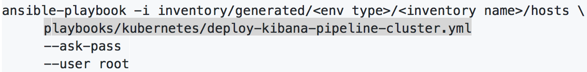
Kibana Ansible Playbook
Run ES playbook to deploy ES as below
Verify:
kubectl get ds -n kube-system | grep pipeline
kubectl get pods -n kube-system | grep pipeline
kubectl get svc -n kube-system | grep pipeline

Slide 49
Kibana UI
https://<<MGT FQDN>>:8443/gateway/default/kibanapipeline/app/kibana/

Slide 50
Summary

